Slide 1
FOSS LAB PROJECT
TEAM MEMBERS
AMUDHA KC Roll No.13
ANAGHA JAYARAJ Roll No.14
ANAGHA MARIYA SAJAN Roll No.15
ANAGHA S Roll No.16

Slide 2
Display process status of a given
process.
We implemented our project using PyQt5

Slide 3
PyQt5
There are so many options provided by Python to develop GUI application and PyQt5 is one of them
01
PyQt5 is cross-platform GUI toolkit, a set of python bindings for Qt v5.
02
One can develop an interactive desktop application with so much ease because of the tools and simplicity provided by this library.
03
A GUI application consists of Front-end and Back-end. PyQt5 has provided a tool called ‘ QtDesigner’ to design the front-end by drag and drop method so that development can become faster and one can give more time on back-end stuff.
04

Slide 4
CODE
import os import sys from PyQt5.QtWidgets import * def main(): app = QApplication(sys.argv) w = MyWindow() w.show() sys.exit(app.exec_())
class MyWindow(QWidget): def __init__(self, *args): QWidget.__init__(self, *args)

Slide 5
label = QLabel(self.tr("Press ENTER to see the status of a default process with PID: 2006 ")) self.le = QLineEdit("PRESS ENTER!") self.te = QTextEdit() layout = QVBoxLayout(self) layout.addWidget(label) layout.addWidget(self.le) layout.addWidget(self.te) self.setLayout(layout) self.le.returnPressed.connect(self.run_command) def run_command(self): cmd = 'cat /proc/2006/status' a = os.popen(cmd).read() self.te.setText(a) if __name__ == "__main__": main()

Slide 6
OUTPUT

Slide 7
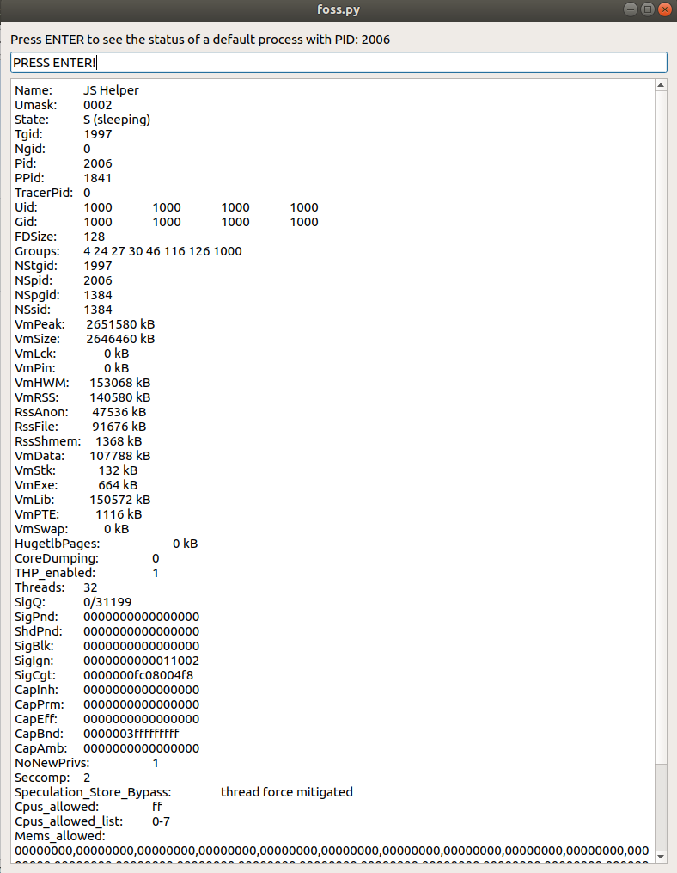


Slide 8


